Slide 1

Making you feel like you’re already traveling to Mars

Slide 2
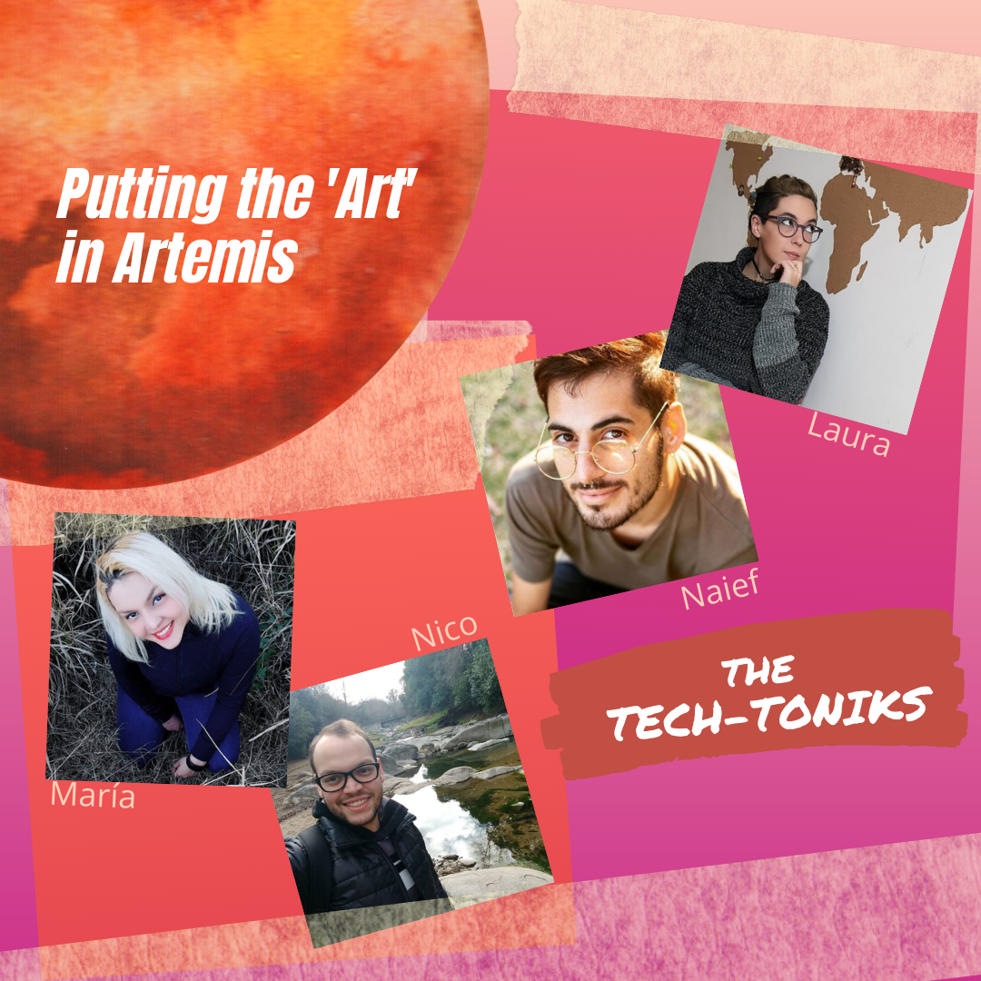
Meet The Team!
MARIA
DOVALE
LAURA
FEU
Ing. Electrónica
Estructura Músical.
Analista de Sistemas.
Directora de Fotografía y video.
NICOLAS
DOVALE
NAIEF
CHANUAR
Ing. Electricista.
Análisis frecuencias de sonido.
Artista.
Composición Musical.

Slide 3
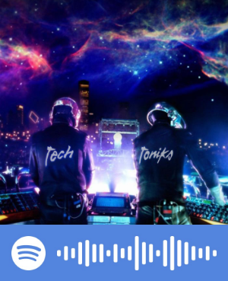
Inspiration
Inspiration came from the ones who lead the world to space!
Listen to this Spotify Playlist we’ve created to create the ‘Art’ for Artemis.
Notes:
https://www.sciencefocus.com/space/space-music-10-of-the-best-songs-about-space/

Slide 4
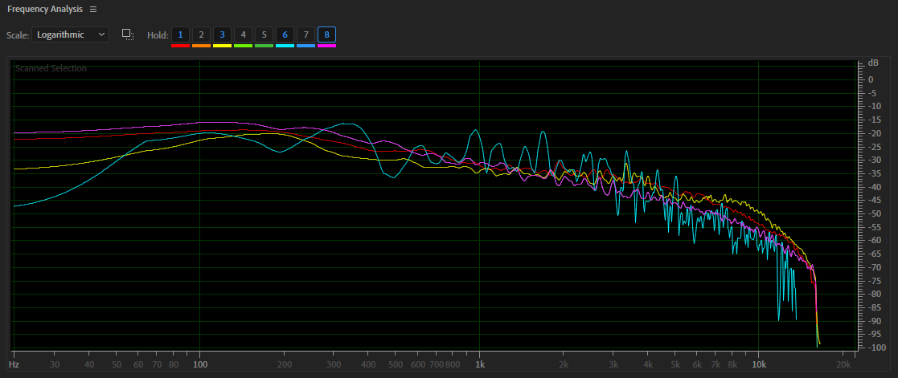
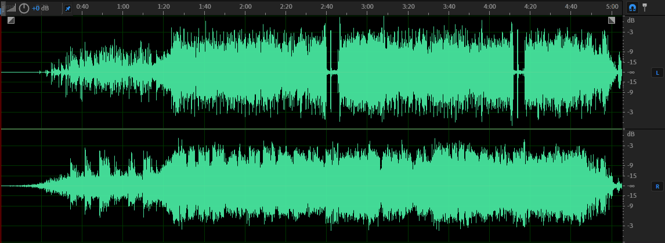
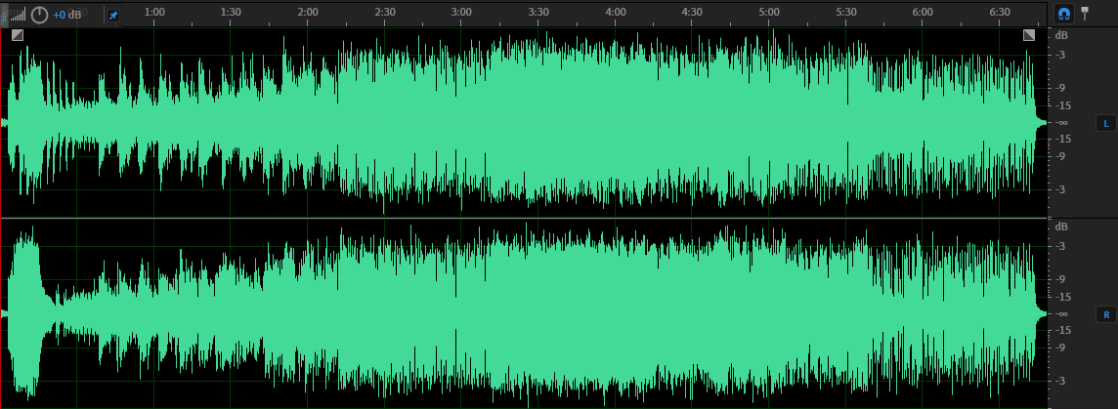
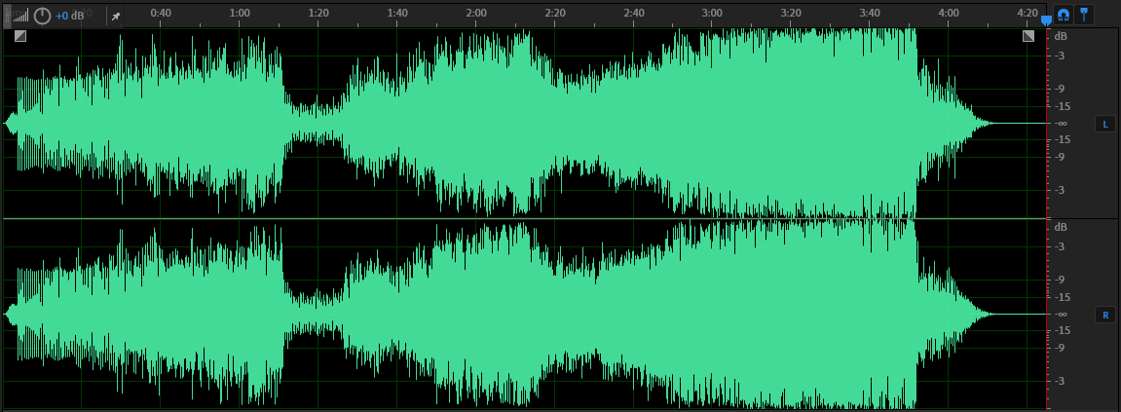
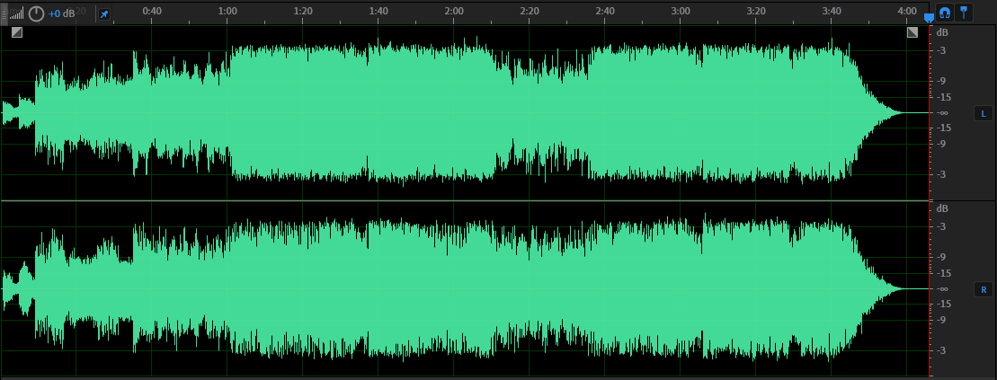
Frecuency Analysis
David Bowie – Space Oddity
Pink Floyd - Time
Spaceman (BABYLON ZOO) Time (Pink Floyd) Space Oddity (David Bowie) Violet - Sputnik (PSB)
Public Service Broadcasting - Sputnik
BABYLON ZOO- Spaceman

Slide 5
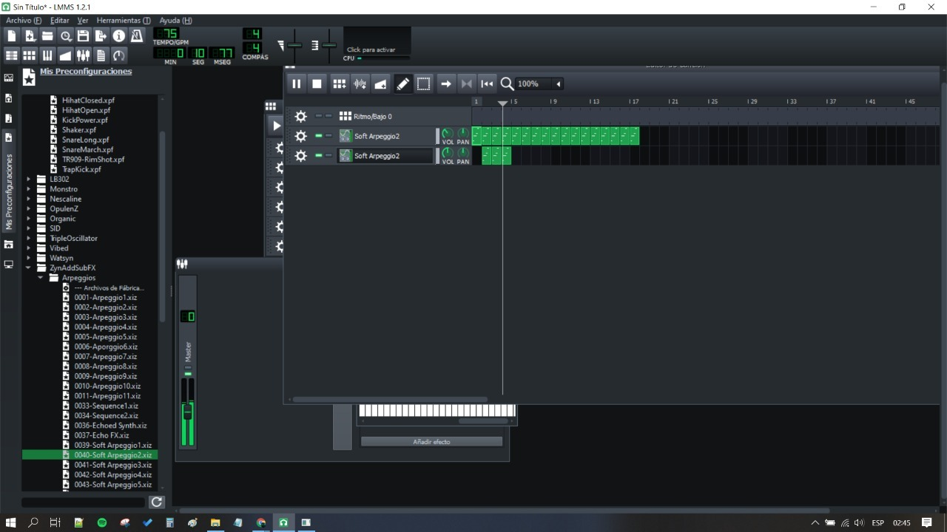
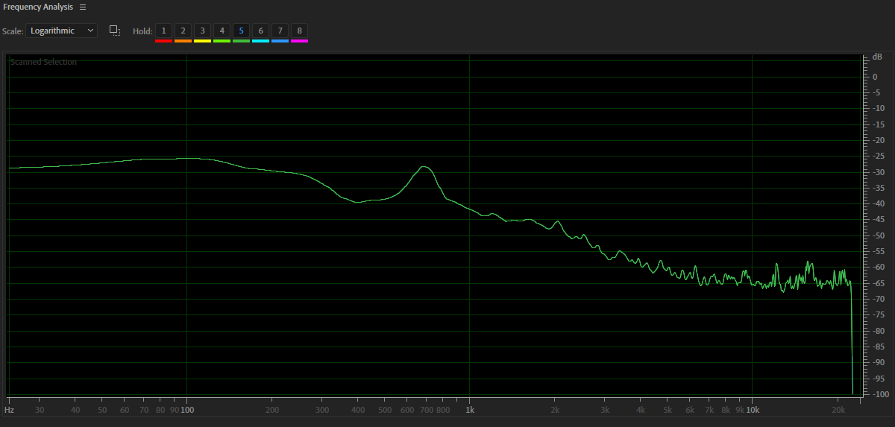
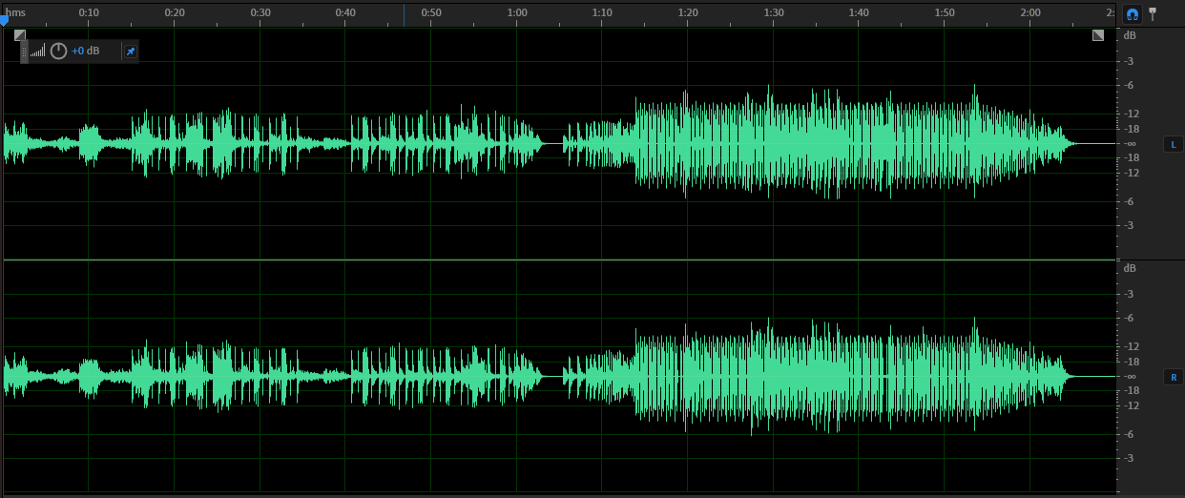



SOLUTION
By using LMMS as a DAW we’ve created sounds to mix with the audio resources provided by NASA.
Through this song we want to encourage to all who listen to it to keep looking up, to enjoy the journey as a mankind we are experiencing prior this milestone which is going to change everything we’ve even known

Slide 6
Would you help us sharing out initiative WORLDWIDE?
MADE IN ARGENTINA
We’ve named our song “One Giant Leap” because for us was also the step we needed to jump creating art and make it meaningful for all of you!

Slide 7
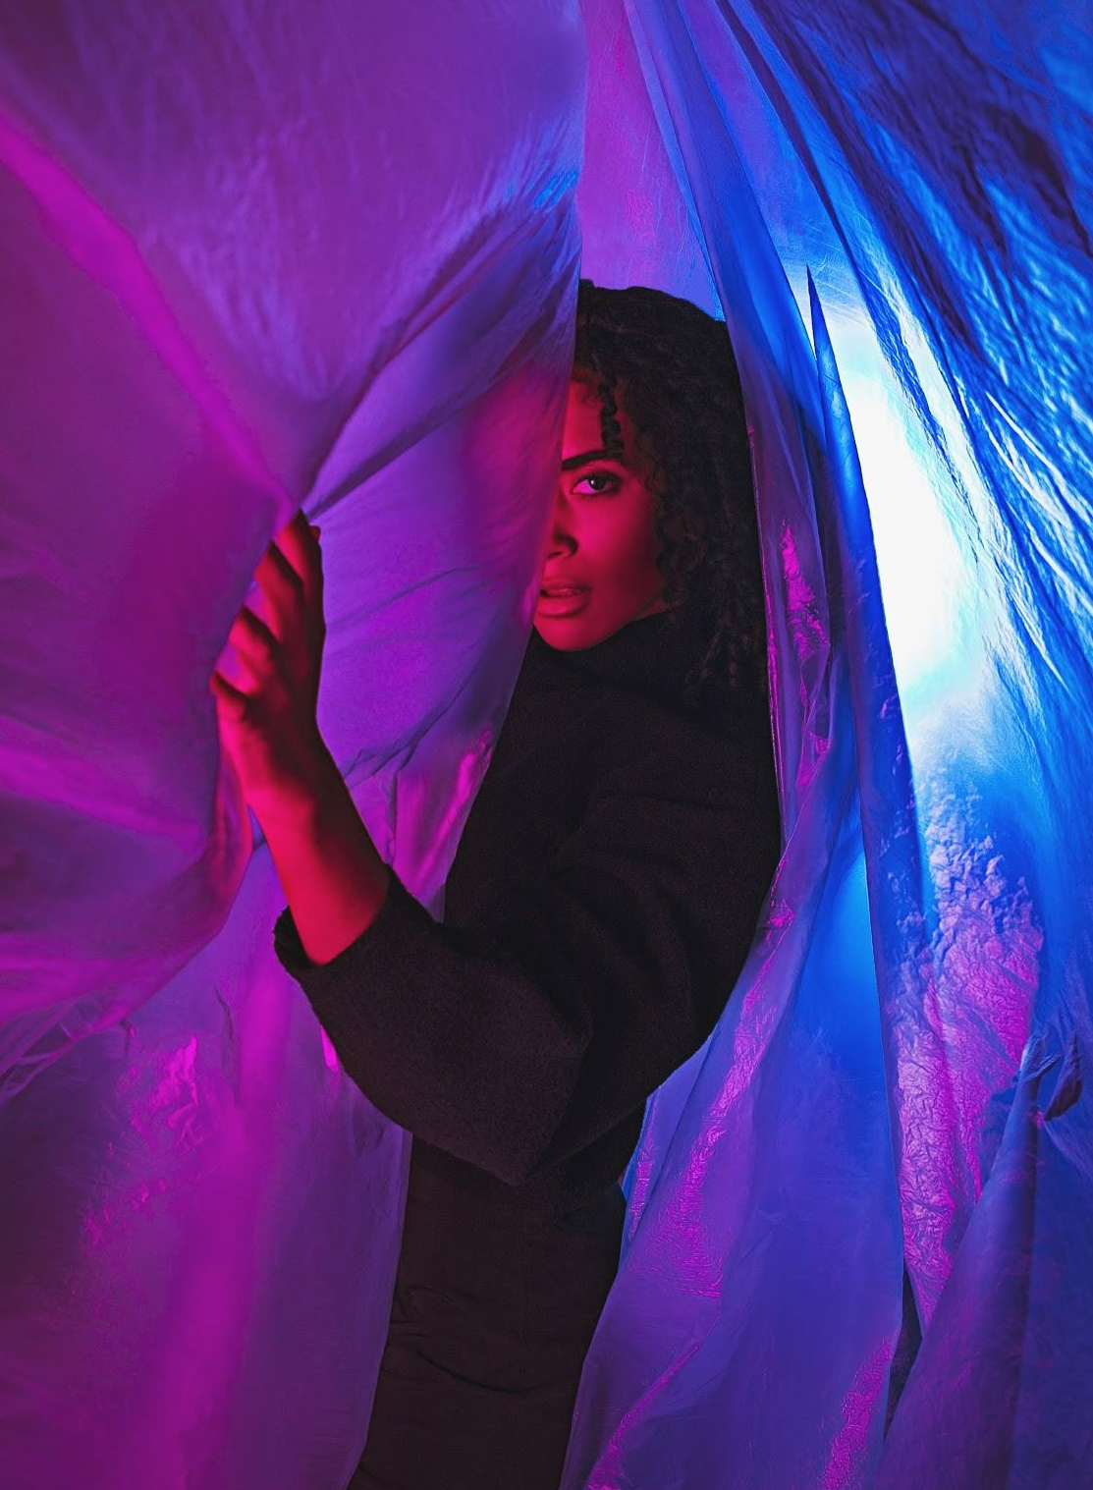
Taking it to the NEXT LEVEL
You will find our song available in all music stores very soon.
And we’ve decided this is the beginning of a new musical spacial project called “The Techtoniks”

Slide 8
Video
The Musical Video for ‘One Giant Leap’ is available in our Youtube Channel

Slide 9

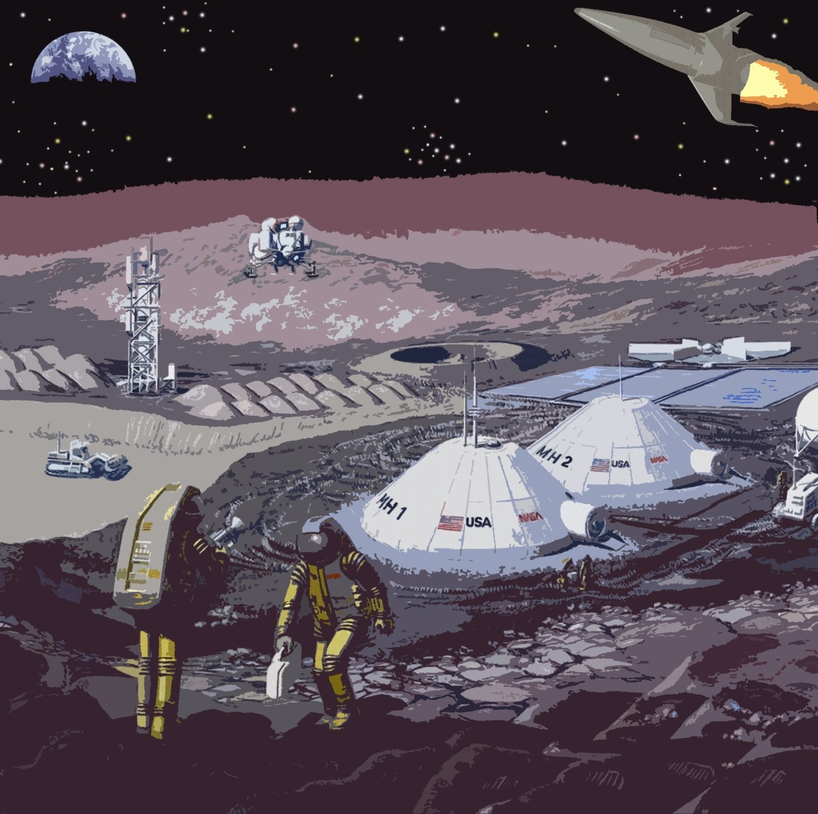
THANK YOU! See you on Mars

